Slide 1



Tactical Detection & Data Analytics Summit
Save the Date: December 4-11 Scottsdale, Arizona
sans.org/summit
SEC455 - SIEM Design & Implementation
SEC599 – Defeating Advanced Adversaries
SEC530 – Defensible Security Architecture
SEC555 – SIEM with Tactical Analytics
SEC511 – Continuous Monitoring & Security Operations
SIEM NetWars
SUMMIT
Dec. 4-5
TRAINING
Dec. 6-11
sans.org/summit
Notes:
Drag Picture and Send to Back

Slide 2
SEC530
Defensible Security Architecture
Zero Trust Architecture
Justin Henderson (GSE # 108)
@SecurityMapper

Slide 3

About Us
Justin Henderson | @SecurityMapper
SEC555/SEC530/SEC455 Author & Instructor
GIAC GSE # 108, Cyber Guardian Blue and Red
60 industry certifications
And security hobbyist and community supporter
Collecting interns/contributors in bulk (research teams)
Release research to the community

Slide 4
Welcome!
A copy of this talk is available at: https://github.com/HASecuritySolutions/presentations
More free stuff: https://github.com/HASecuritySolutions

Slide 5


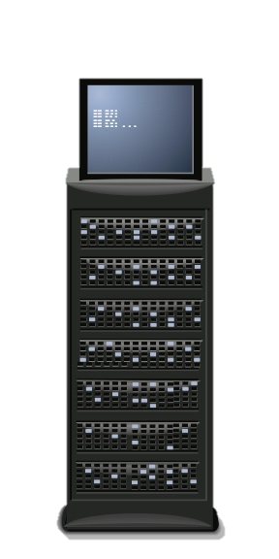


Perimeter Security
Perimeter security is basic in principal
External access is untrusted
Internal access is trusted
Perimeter security has a major failing
Inside access is not always benign
Modern attacks are inside out
Trusted system brings attacker in
Internal access is loosely regulated
Untrusted
Trusted

Slide 6

Segmentation
Segmentation helps but often is not as stringent as it should be
HR Desktops 10.0.0.0/24
DCs 192.168.10.0/24
IT Desktops 10.0.0.0/24
DMZ 172.16.2.0/24

Slide 7

Danger Zone = Internal Network
Exploitation = Possible but not necessary
Compromise via logins
jhenderson

Slide 8
Zero Trust Architecture
Developed by Forrester's John Kindervag in 2010¹
Data-centric focus
Basic principles of zero trust:
Network is always hostile
Internal and external threats are always present
Internal network is not sufficient to equal trusted
Every device, user, and network flow must be proven
Log and inspect all traffic

Slide 9
Trust Over Time
Security Measures
Risk to systems increase over time
Systems need to be reloaded
Due to deviations from baseline
Credentials need to be rotated
Limits compromise and reuse
Certificates need to be replaced
Limits compromise and reuse
Cycling time increases with security
But still should take place
Initial Trust
Lack of Trust
Time till next reload

Slide 10

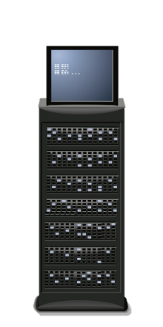
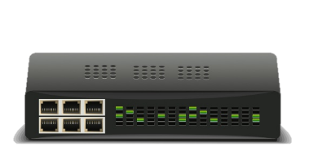

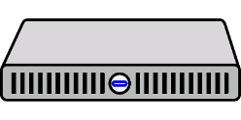
Traditional Communication
Traditional network design
Encryption used over internet
Used in DMZ services
Internal communication is cleartext
Workstations to server
Server to server
VPN to server
DMZ
Internal
VPN

Slide 11
Securing Traffic
Under zero trust all network traffic MUST be
Authenticated - Prove user/device is legitimate
Encrypted - Cryptographically prove source and destination while protecting confidentiality
Encryption cannot be perimeter-based
Requires encryption at either device or application
Endpoints configured to drop anything not encrypted

Slide 12




Trust Model Change
Computer authentication is often one-way
Example: SSL/TLS
Client connects to TLS site and authenticates server
Client is commonly not verified
Yet SSL/TLS support mutual authentication
web.sec530.com
pc1.sec530.com

Slide 13
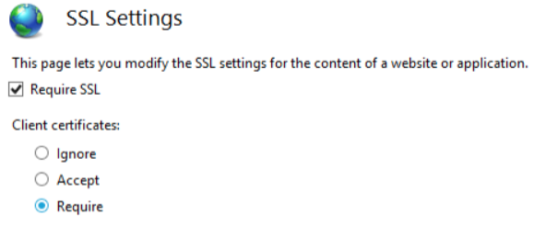
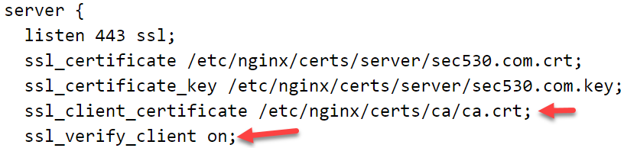
Client Certificates
Enabling mutual authentication requires simple change
May just require clicking a radio button
Or adding some text to a configuration file
Requires clients to have certificates and a CA

Slide 14
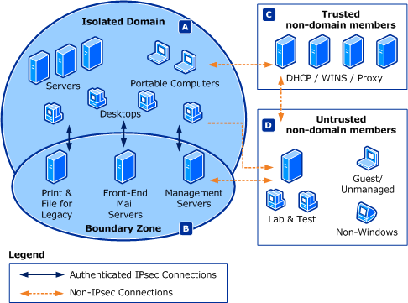
Windows Domain Isolation
Windows natively supports IPSec for domain isolation
Blocks unauthorized non-domain access
Authenticates all traffic
Mutually authenticated
Optionally encrypts traffic
Cannot attack the invisible
Mitigates man-in-the-middle
Lowers service exploitation risk

Slide 15
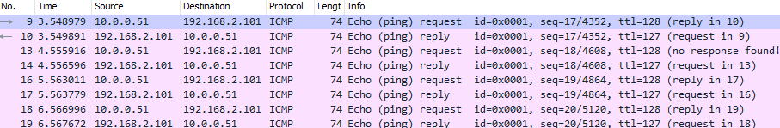
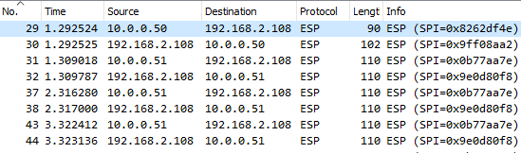
Windows Ping Example
Without IPSec
With IPSec

Slide 16



Single Packet Authorization (SPA)
SPA involves blocking connections by default
Connecting system must first send authentication packet
Associated as a next-generation port knocking solution
SPA uses asymmetric encryption and HMAC
Packet is non-replayable due to HMAC and random data
SPA includes request to authorize port or program
1. Port scan 22
2. SPA sent
3. Port scan 22
Port 22 listening
Protected by SPA

Slide 17

Variable Trust
Access controlled by variable trust
Similar to real-life credit scores
User authentication with username/password 10 points
Device authentication 10 points
Known device and location 10 points
Access to PCI database requires 40 points
Multifactor authentication with smart card 20 points
Access to PCI database GRANTED

Slide 18
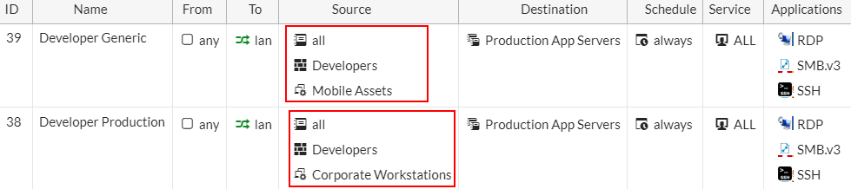
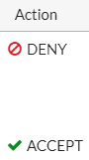
Network Agent
Network Agent = User + Device
Developer on corporate desktop has access to source code
Developer on mobile device does not
Trust is calculated by user, device, and other factors

Slide 19
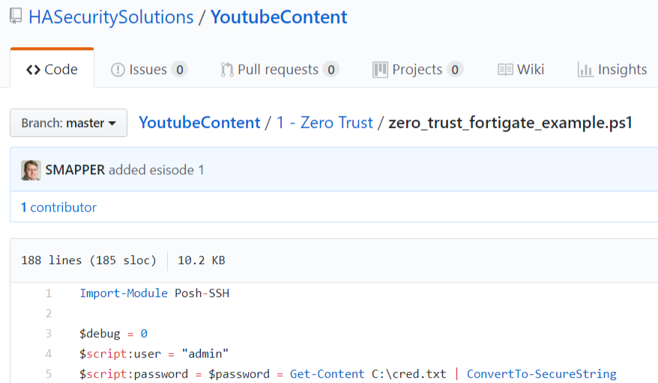
Off-the-wall Zero Trust Implementation

Slide 20
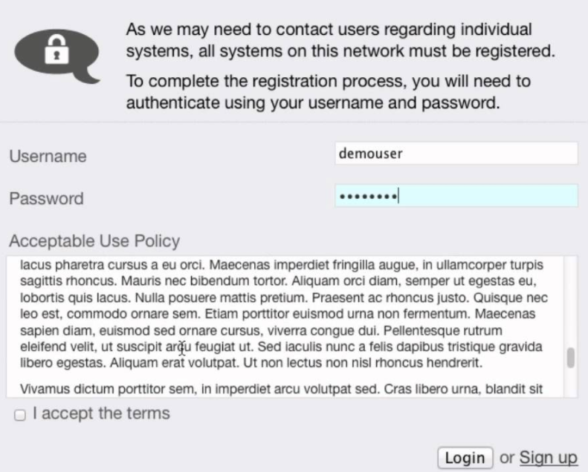
Captive Portal
Often used as part of NAC/wireless solution
If device fails 802.1X fallback to captive portal
Design is flexible and dynamic
Terms and conditions only
Gives guest VLAN access
AD authentication
Provides limited production access
Captive portal could be forced even with authentication

Slide 21
Log Inspection
All system and network access needs verified
Ad hoc reporting is inefficient and difficult to do
Central log collection and scripting is low cost
But also suffers from major deficiencies
SIEM log collection and analysis is recommended
Focus should be on key log sources
And inspecting them for expected network and system use
Use log enrichment to enhance analysis

Slide 22






Security Information and Event Management (SIEM)
What is a SIEM used for?
Centralized log collection
Advanced alerting
Systems automation
Analysis system
Compliance repository
Big data analytics platform
Threat intelligence
SIEM != log collection
It can do so much more

Slide 23
Log Enrichment
query: www.google.com
query: www.google.com
subdomain: www
parent_domain: google
registered_domain: google.com
creation_date: 1997-09-15
tags: top-1m
geo.asn: Google Inc.
frequency_score: 18.2778256342
parent_domain_length: 6
Enriches to this

Slide 24
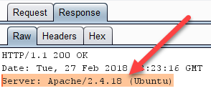
Service Banners
Many applications identify their software and version number upon connection
Attackers and malware use information for exploitation
Possible to change version, application, or OS identification
May be sufficient to break automated attack tools and scans
Implemented at the local server or with a reverse proxy
Alternative is to hide or limit information
May break automated attacks
But less effective

Slide 25
Minimizing Service Banners
Services may natively support hiding or limiting service information
Apache uses ServerTokens directive
ServerTokens Full (Full or OS default for Apache)
Apache 2.4.18 (Ubuntu) PHP/7.2.2
ServerTokens OS
Apache/2.4.18 (Ubuntu)
ServerTokens ProductOnly (banner with least info shown)
Apache

Slide 26


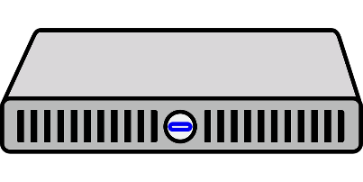
Detection Capabilities
Meaning of detection based on attack source and destination
External - Early detection of external threat
Expected true positives (may occur so much as to be noise)
Internal - Early detection of insider threat
Low false positives and true positives (high fidelity alert)
Rewrites banner as: Microsoft/IIS 8.5
Web Server Running: Apache 2.4.18

Slide 27
Tactical Detection & Data Analytics Summit
Save the Date: December 4-11 Scottsdale, Arizona
sans.org/summit
SEC455 - SIEM Design & Implementation
SEC599 – Defeating Advanced Adversaries
SEC530 – Defensible Security Architecture
SEC555 – SIEM with Tactical Analytics
SEC511 – Continuous Monitoring & Security Operations
SIEM NetWars
SUMMIT
Dec. 4-5
TRAINING
Dec. 6-11
sans.org/summit
Notes:
Drag Picture and Send to Back

